Slide 2
A 32-Year-Old Pregnant Woman With Multiple Vertebral Fractures

Slide 11
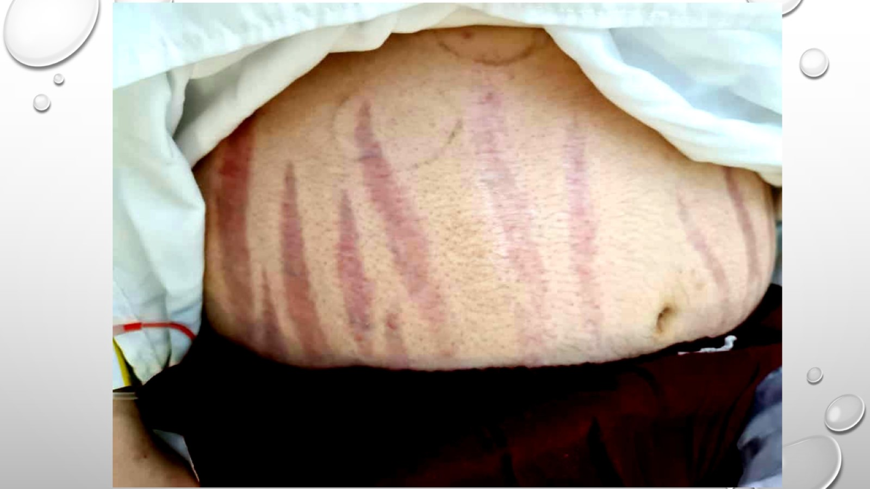

Slide 12
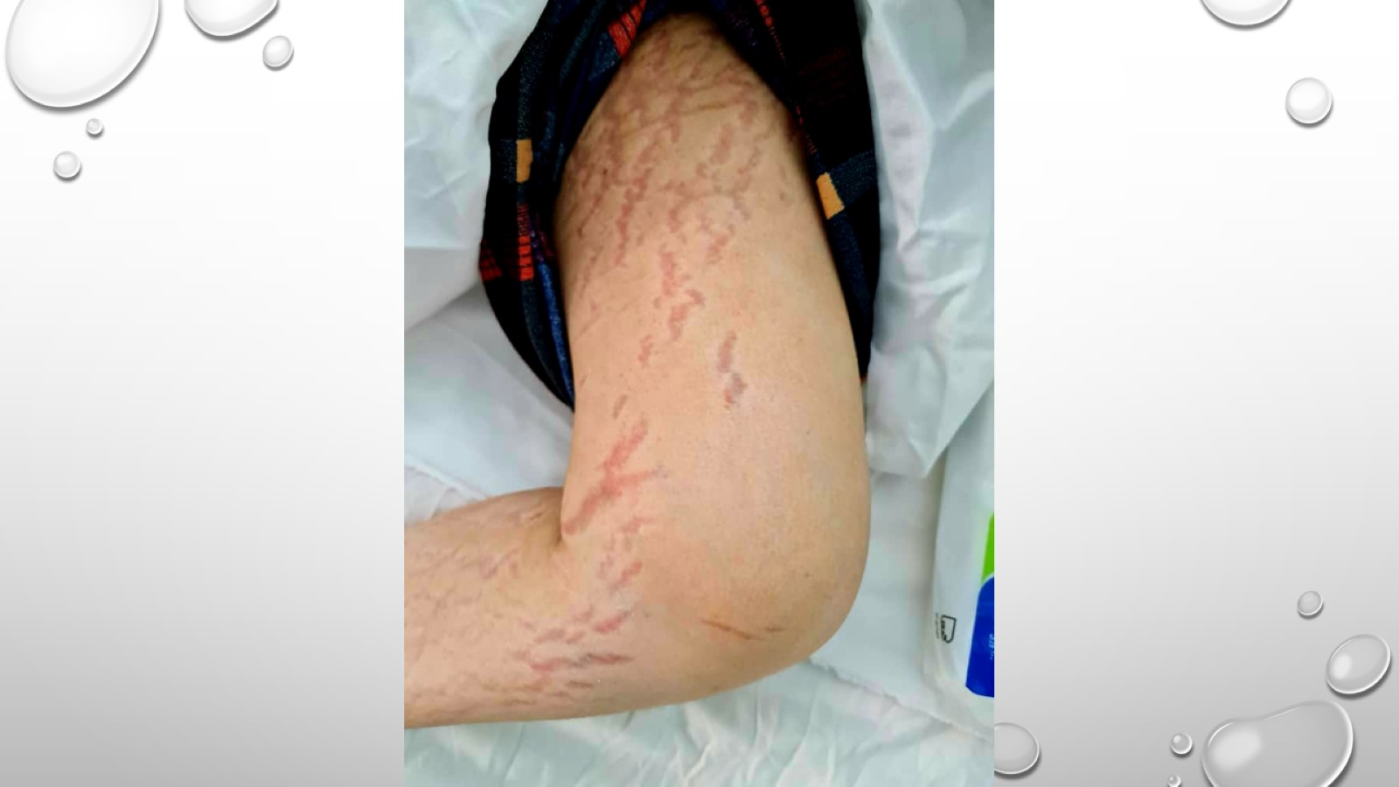

Slide 13
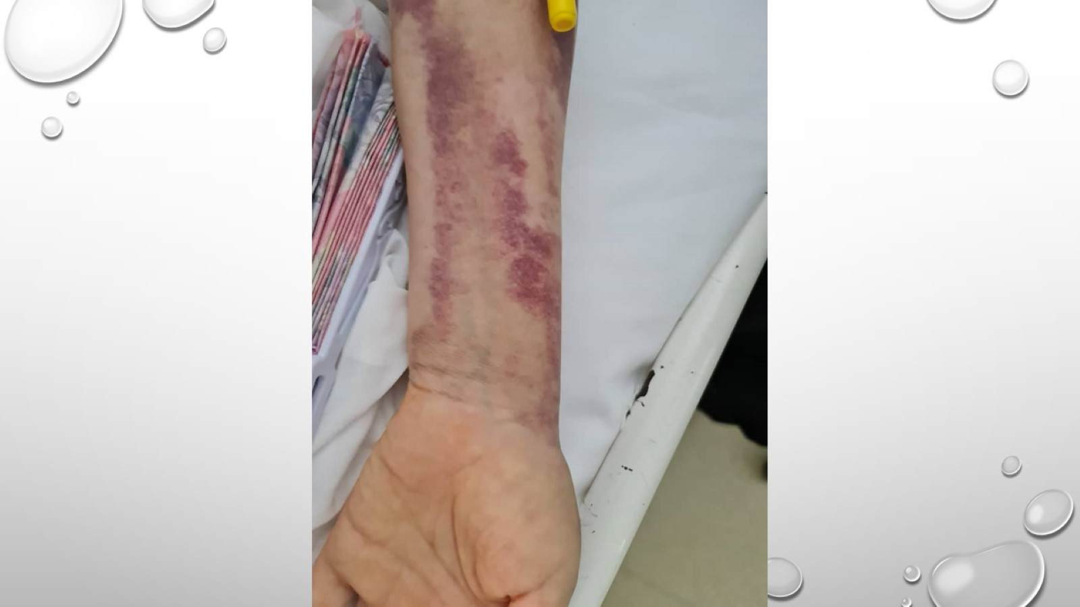

Slide 14
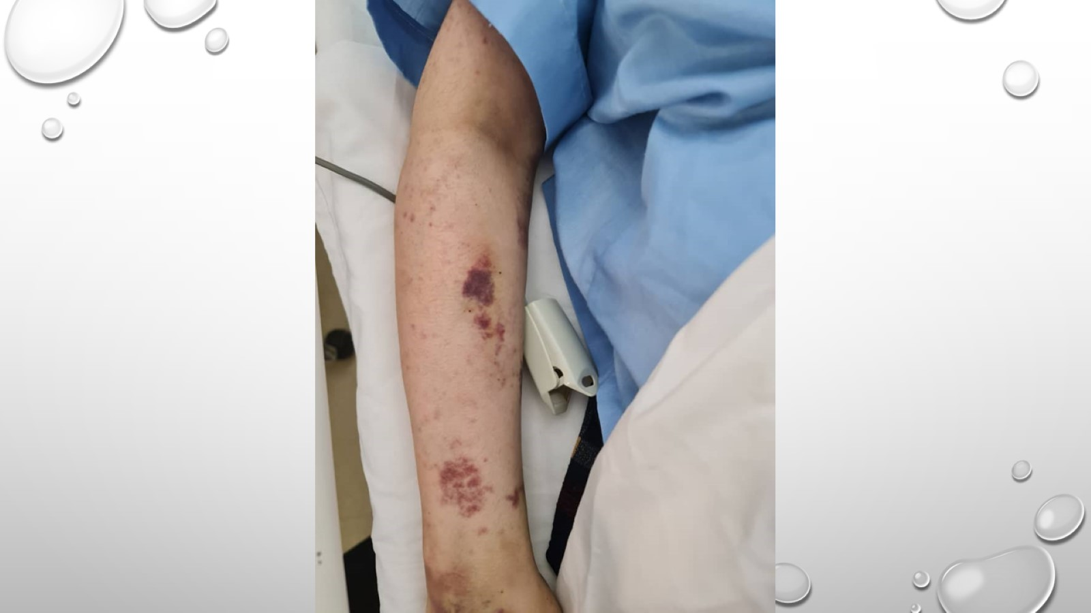

Slide 15
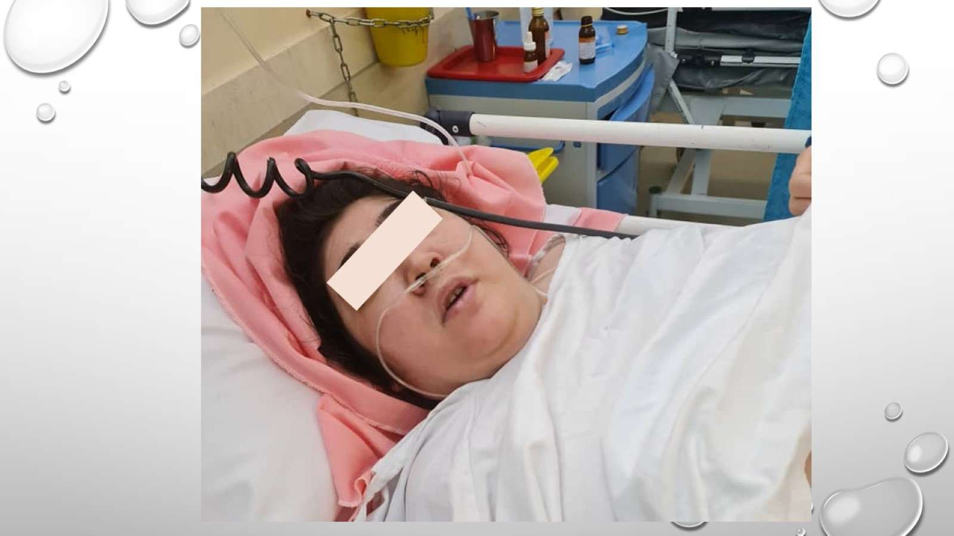

Slide 19
Hypothalamic–pituitary–adrenal Axis During Normal Pregnancy.

Slide 21
The physiological increase in CRH/ACTH during pregnancy causes a slight elevation of cortisol levels (serum, salivary, and urinary).

Slide 25
Fetal Outcomes

Slide 26
Biochemical Confirmation Of CS During Pregnancy

Slide 28
Late Night Salivary Cortisol

Slide 29
UFC

Slide 30
Plasma ACTH

Slide 31
Adrenal Imaging

Slide 35
Management Of Pregnant Patients With Cushing’s Syndrome

Slide 38
Metyrapone

Slide 39
Ketoconazole

Slide 40
Adrenalectomy

